Slide 1
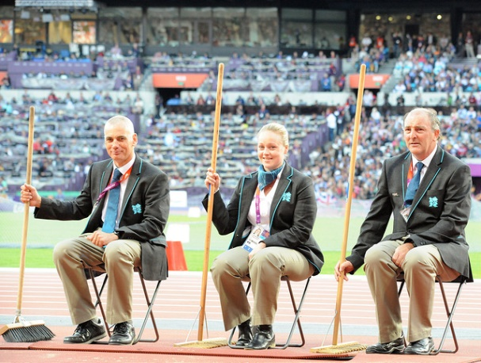
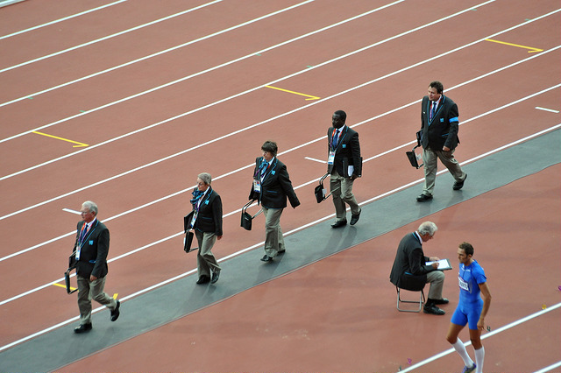
Stepping Up…
(& Sitting Down)
A guide through the Officials Pathway
Welsh Athletics Officials Conference – March 2021
Geoff Wickens &
Sue Maughan
Notes:
Geoff – TK Level 4; Sue – Field Level 4

Slide 2
Why do we need officials?
What is an official?
Why become an official?

Slide 3
UKA Track & Field Officials Pathway

Slide 4
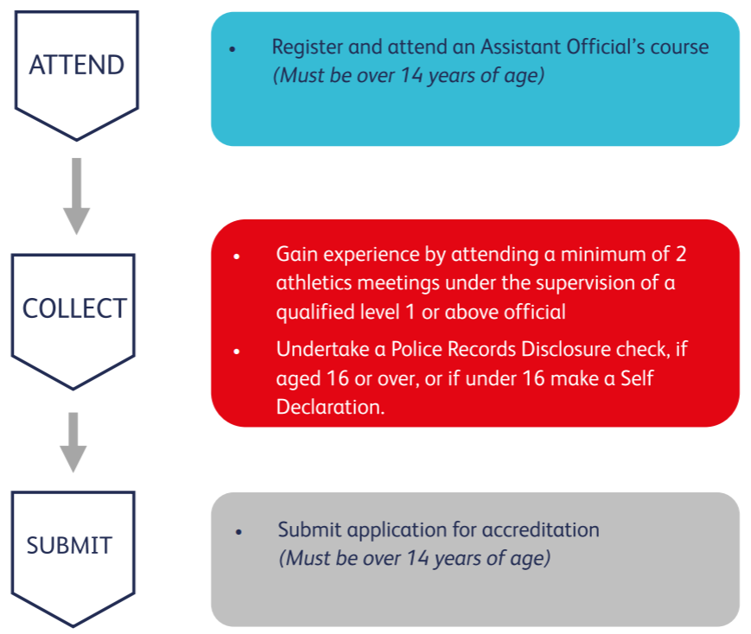
UKA Assistant Official
Notes:
Minimum age 14, qualify at 16

Slide 5
Discipline Specific Courses
Endurance
Field
Photofinish
Timekeeping
Track
Starter & Starter Assistant
Walks
Additional compulsory courses
Health & Safety (online – all disciplines)
Risk Awareness (Endurance)

Slide 6
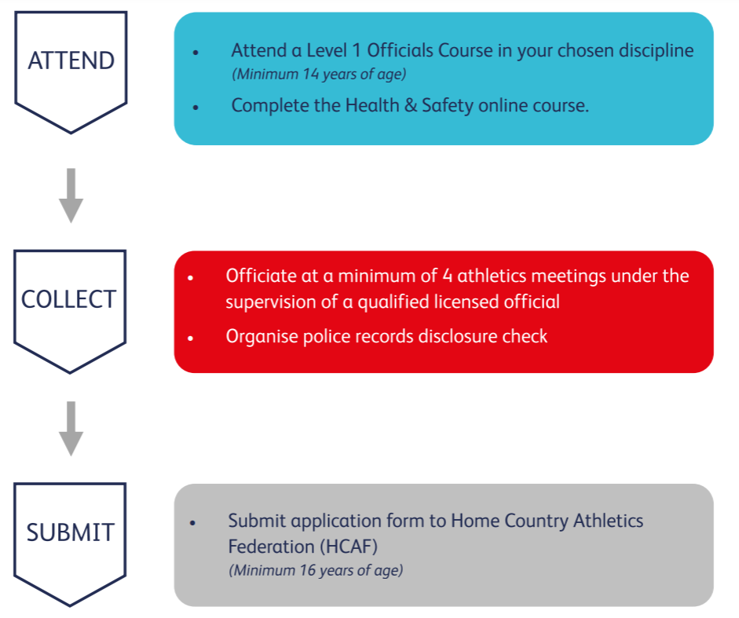
UKA Level 1 Official
FIELD: including a shot put, a long throw, a horizontal jump and a vertical jump (Detailed on RoE or Form)
NB Contact your club or Welsh Athletics for details of opportunities

Slide 7
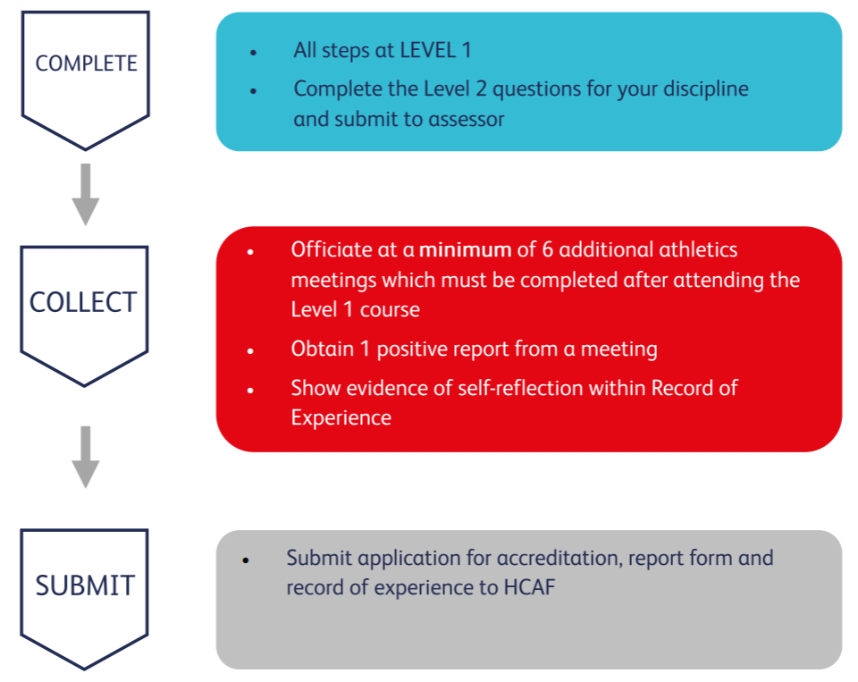
UKA Level 2 Official
Notes:
More experiential base
Report by level 3 and above
Q’s – open book… score 75% and then can resubmit if not a pass
Use of a mentor
Contact Sue Hooper re help in identifying someone to do a report

Slide 8
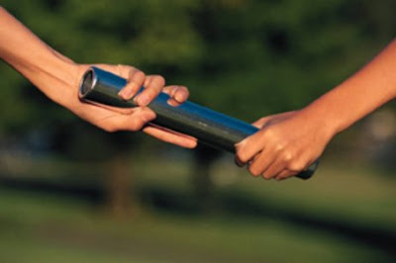
Quick baton pass…..

Slide 9
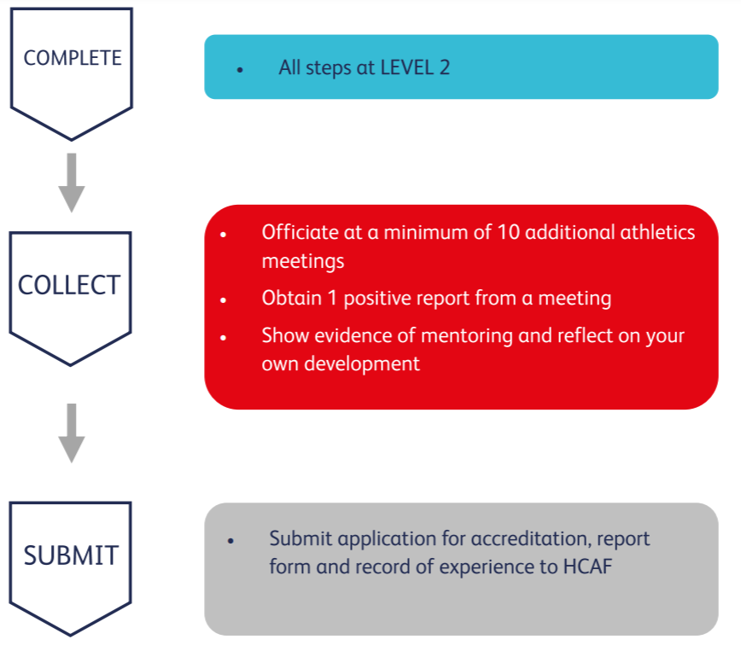
UKA Level 3 Official
Notes:
Report / submit to committee

Slide 10
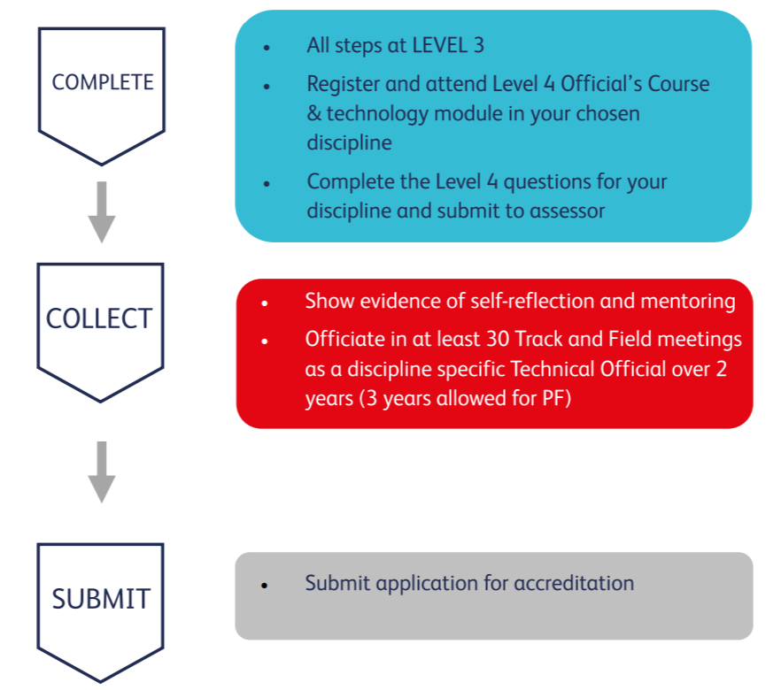
UKA Level 4 Official
Submit reports of successful experience at a minimum of six events to include specific duties as given below:-
The reports;
One as a chief official/Referee at a league match or county championship or similar equivalent event
Two as a member of a team of officials
One from a reporter outside your region or other Home Countries equivalent.
One as a clerk of course
One using relevant technology
Notes:
The UKA Athletics Level 4 course is a progression from Level 3 that both consolidates learning at Level 3 and prepares the official to operate at National and International level through the introduction of additional modules including the use of appropriate technology. Officials who have satisfied the requirements of the level 4 accreditation will be listed as Level 4P for two years after qualification but will immediately become eligible to receive information regarding selection for national and International competition under the auspices of UKA. This is a probationary period during which positive assessments are required in order for the official to remain eligible for selection for such competitions. Level 3 officials wishing to move to level 4
• Must attend the generic, discipline specific and technology modules relevant to their discipline.
• Must complete an Annual Record of Experience form in detail to include information about what has been learnt at the meetings listed. • Show evidence of officiating at a minimum of 30 meetings over two years (three for photo finish). This must include meetings at county and area level as well as grassroots level. It should be recognised that moving from Level 3 to Level 4 is a big step and anyone seeking to do this should be gaining as much varied experience as possible which may well take several years before being ready to apply.
• Work with an appropriate mentor
• Undergo assessment of competence and knowledge and understanding of UKA and WA &WPA rules and the differences between them by answering a set of questions which will be found on the UKA website on June 1st each year.

Slide 11
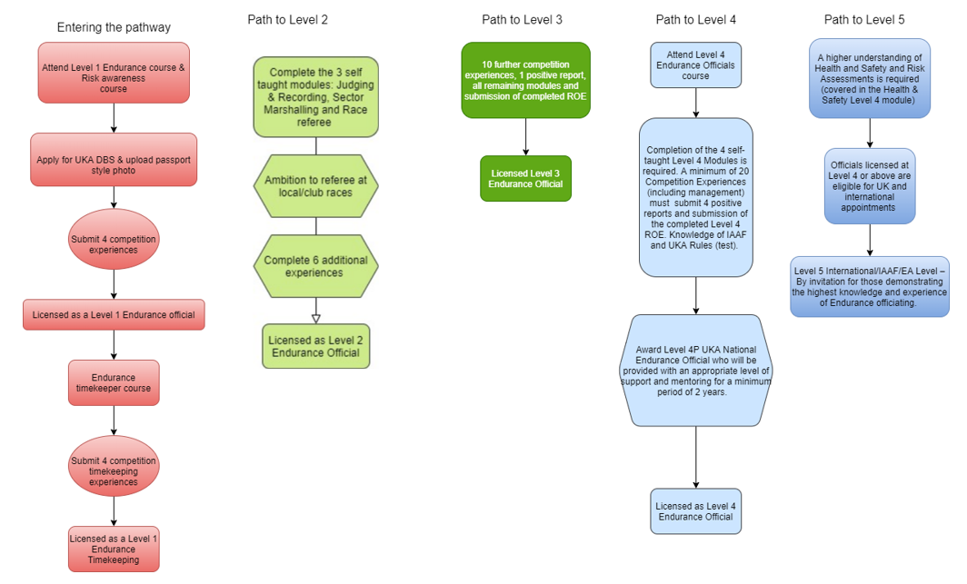
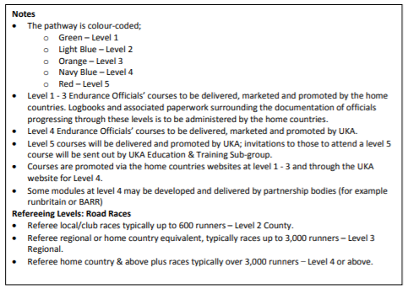
UKA Endurance Pathway
http://www.uka.org.uk/wp-content/uploads/2020/03/Endurance-Official-Pathway-May-2017.pdf
Notes:
Minimum age 16 – qualify at 18

Slide 12
Quiz… so, how good is your maths, and your memory!
Work out the following sum…… Minimum Number of meetings you need to officiate at to become
Level 1 | + | Level 3 | - | Level 2 | + | Level 4
Add to this figure, the number of reports you need to become
Level 2
Level 3
Level 4

Slide 13
Quiz… how good was your maths!
4 | + | 10 | - | 6 | + | 30
= 38
Add to this figure, the number of reports you need to become
Level 2 1
Level 3 1
Level 4 6 = 46

Slide 14
Competition Management Award (CMA)
An Official that achieves the full CMA may be described as ‘an Official with a wide range of experience who has proven ability to’:-
Act as Referee/Chief in a technical discipline, including completing reports on meetings and Officials on time.
Work in roles other than as a discipline specific Technical Official at a range of meetings.
Officiate competently at events for athletes with a disability.
Act as a mentor to other Officials.
Attendance at the Management Structure and Leadership module is recommended for all officials who aspire to act as Referee or Chief at National/International events
https://www.uka.org.uk/officials/track-and-field/education-and-training/competition-management-award/

Slide 15
Competition Management Award (CMA)
Who can register to attend
Level 2 Official for CPD
Level 3 Official for CPD or to work towards CMA award
Modules
Management, Structure and Leadership
Mentoring, Assessment and reporting
Disability (either track or field)
Plus 2 modules from:
Meeting Manager
Call Room
Technical Information Centre (TIC)
Disability (the module not covered above)

Slide 16
Competition Management Award (CMA)
Assessment for this award will be by:
Observation of the candidate in the position of Chief / Referee at two appropriate meetings.
Evidence of working at events for athletes with a disability (by production of the Annual Record of Experience).
Scrutiny of the annual record, which needs to show a range of duties carried out other than as a discipline specific Technical Official including such roles as Meeting Manager, Call Room Manager etc as appropriate. The candidate may also be asked to provide a statement summarising this experience.
Evidence of mentoring, including the provision to request a statement from the candidate as to the mentoring they have done, and contacting some of those who have been mentored
Notes:
Not obligatory to get qualified in other disciplines but recommended if you want to progress as L 5 multi *being checked and as soon as I can confirm we can update.

Slide 17
Peer Group
Group of senior Officials in each discipline (field, track, starters, photofinish, timekeepers)
Will have held a referee role over past 2 years
Selected by their peers
Role of Peer Group
Selection of Officials for televised meetings (based on nominations from each region)
Select Technical Officials & Referees
Update Level 2 & Level 4 Questions
Mark Level 4 Questions
Review Applications for Level 4
Review Level 4P Officials
Notes:
Not obligatory to get qualified in other disciplines but recommended if you want to progress as L 5 multi

Slide 18
Level 5
By invitation for those demonstrating the highest knowledge and experience of Track & Field officiating, providing they hold a valid Level 4 license.
Operates at
World Athletics (WA)
European Athletics (EA)
World Para Athletics (WPA)
Requirement to pass an exam (covering all disciplines)
Limited number across each discipline within the UK
Roles include ITO; Technical Delegates; Jury Members

Slide 19
Thank you
Any Questions?

